Slide 1

Fiori@Bosch
Fiori@Bosch

Slide 2
Content
Fiori@Bosch
SAP Fiori
Bosch Fiori Strategy
Bosch Fiori System Landscape
Bosch Fiori Client Strategy
Bosch Fiori Collaboration Model
Bosch Fiori Role and Authorization Concept
Bosch Fiori Development
Fiori Information & Examples
2
CI/BAA-UX | 27.07.2017
© Robert Bosch GmbH 2016. Alle Rechte vorbehalten, auch bzgl. jeder Verfügung, Verwertung, Reproduktion, Bearbeitung, Weitergabe sowie für den Fall von Schutzrechtsanmeldungen.

Slide 3
SAP FiorI

Slide 4

SAP`s general UX Strategy
SAP Fiori
Business Suite renovation
Usage
New & Renewal (SAP standard)
Enabling tools (customer specific UIs)
SAP UI5 (Fiori technology)
Future Direction
SAP HTML Gui, WebDynpro ABAP & Floorplan Manager
Power Transaction
(SAP focuses more & more on Fiori)
Visual
Harmonization
SAP Screen Personas
Simplification of SAP GUIs (temporary)
Fiori
Self-service scenarios
Core use scenarios
Specialization
SAP GUI
Legacy
4
CI/BAA-UX | 27.07.2017
© Robert Bosch GmbH 2016. Alle Rechte vorbehalten, auch bzgl. jeder Verfügung, Verwertung, Reproduktion, Bearbeitung, Weitergabe sowie für den Fall von Schutzrechtsanmeldungen.

Slide 5
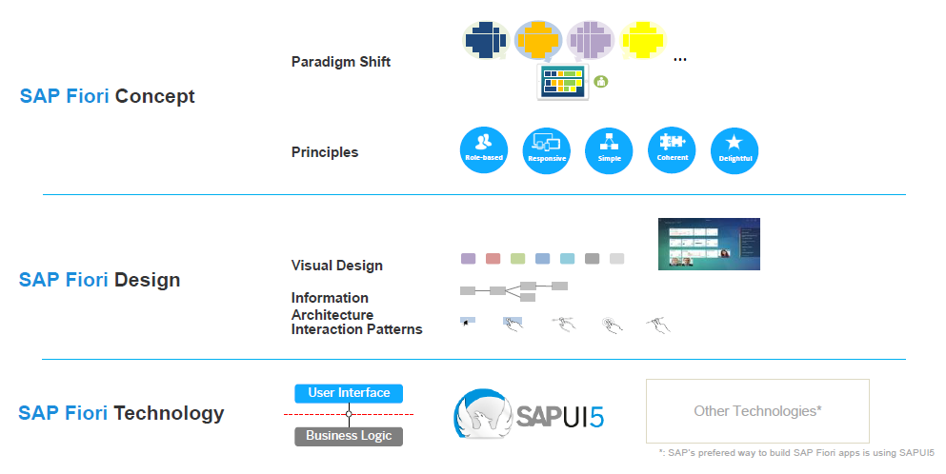
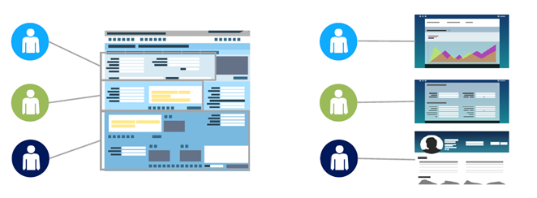
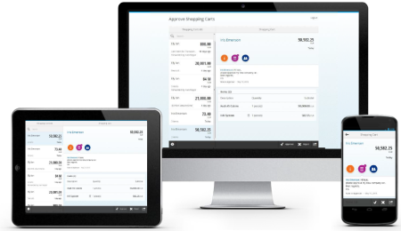
SAP`s Fiori UX Strategy
SAP Fiori
Benefit
Intuitive user interfaces providing relevant features for user task
New visual design
Designed for mobile
Flexibility by user interfaces decoupled from business logic
Fit for Bosch IT Architecture
5
CI/BAA-UX | 27.07.2017
© Robert Bosch GmbH 2016. Alle Rechte vorbehalten, auch bzgl. jeder Verfügung, Verwertung, Reproduktion, Bearbeitung, Weitergabe sowie für den Fall von Schutzrechtsanmeldungen.

Slide 6
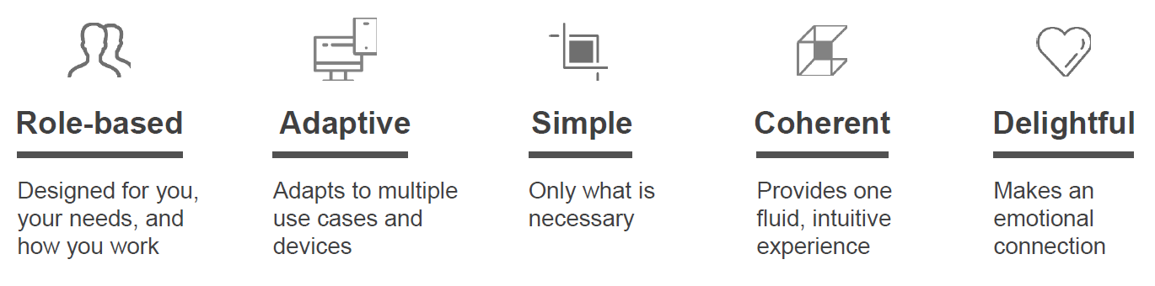
SAP Fiori Design Principles
SAP Fiori
6
CI/BAA-UX | 27.07.2017
© Robert Bosch GmbH 2016. Alle Rechte vorbehalten, auch bzgl. jeder Verfügung, Verwertung, Reproduktion, Bearbeitung, Weitergabe sowie für den Fall von Schutzrechtsanmeldungen.

Slide 7
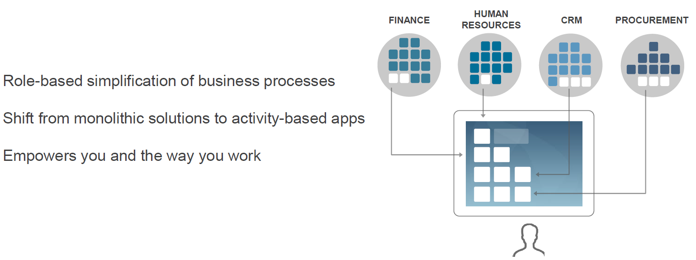
SAP Fiori Launchpad – Single Point of Entry
SAP Fiori
7
CI/BAA-UX | 27.07.2017
© Robert Bosch GmbH 2016. Alle Rechte vorbehalten, auch bzgl. jeder Verfügung, Verwertung, Reproduktion, Bearbeitung, Weitergabe sowie für den Fall von Schutzrechtsanmeldungen.

Slide 8
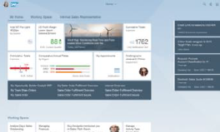
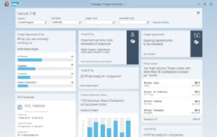
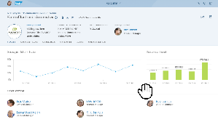
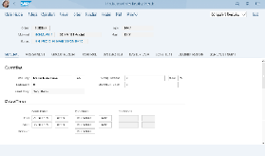
SAP Fiori for S/4HANA
SAP Fiori
Single point of entry for Business User
Infos & Actions for user flow *
* Overview Page: Minimum SAP Release SAP NW 7.50
Capture details and work in depth
SAP Fiori
Visually harmonized
8
CI/BAA-UX | 27.07.2017
© Robert Bosch GmbH 2016. Alle Rechte vorbehalten, auch bzgl. jeder Verfügung, Verwertung, Reproduktion, Bearbeitung, Weitergabe sowie für den Fall von Schutzrechtsanmeldungen.

Slide 9
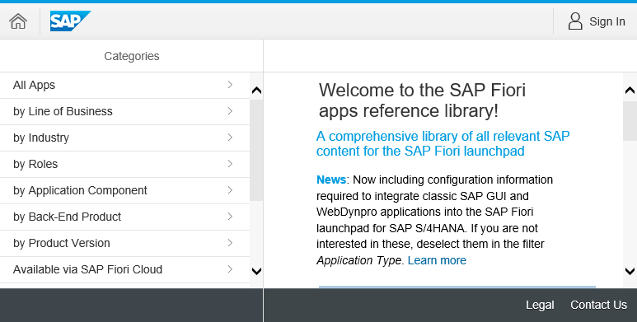
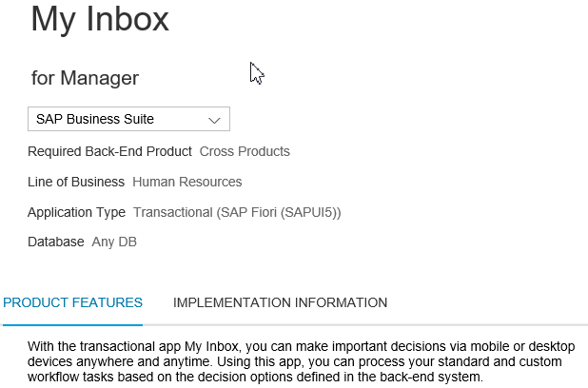

SAP Fiori App Library
SAP Fiori
General Information
User Role and LoB
Backend Requirements (HANA/AnyDB)
Search apps by various categories and filters
?
SAP Fiori App Library
Contain Information for ~7500 SAP Fiori apps and components (12/2016)
Product features
Key Features
Screenshots
Related apps
Implementation Information
Version History
Installation Details
Configuration & Customizing
Extensibility
Support (Notes & App Component)
9
CI/BAA-UX | 27.07.2017
© Robert Bosch GmbH 2016. Alle Rechte vorbehalten, auch bzgl. jeder Verfügung, Verwertung, Reproduktion, Bearbeitung, Weitergabe sowie für den Fall von Schutzrechtsanmeldungen.

Slide 10
Bosch Fiori Strategy

Slide 11



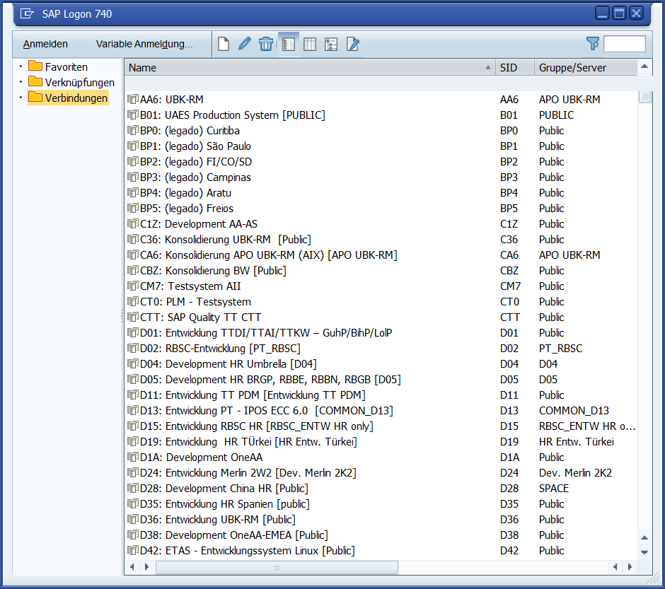
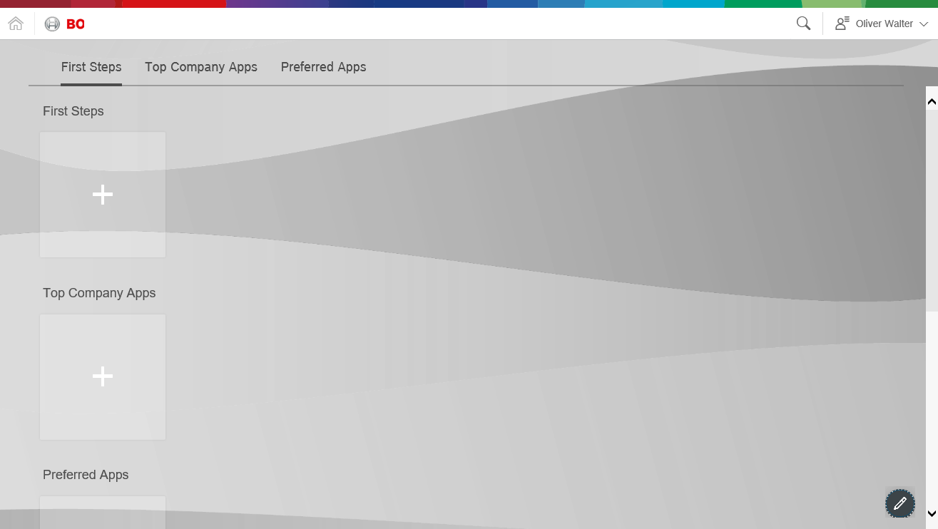
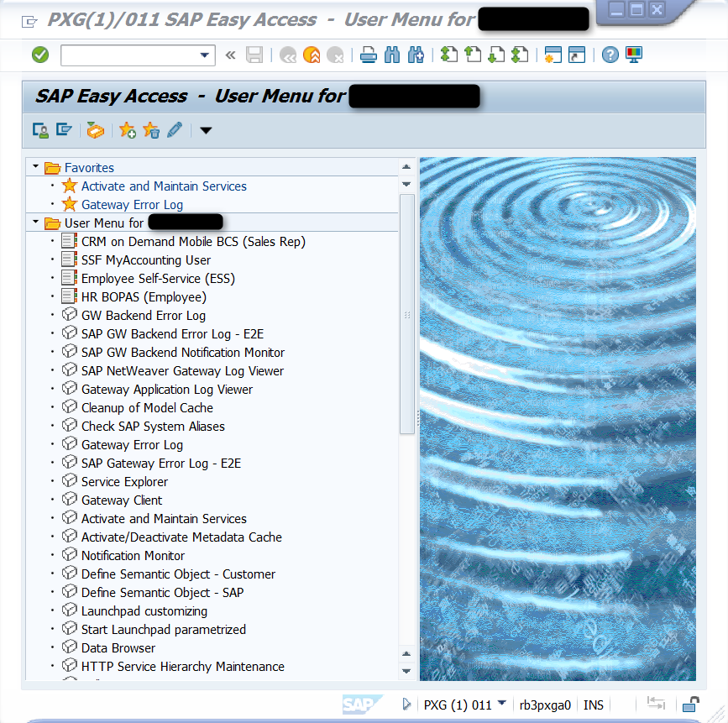
From SAP Gui to Fiori
Bosch Fiori Strategy
SAP Logon Pad / SAP GUI
Launchpad
Cross-Device
Cross-System
Context-based navigation
…
Finance
Human
Resources
Procurement
Non-SAP
Cloud
11
CI/BAA-UX | 27.07.2017
© Robert Bosch GmbH 2016. Alle Rechte vorbehalten, auch bzgl. jeder Verfügung, Verwertung, Reproduktion, Bearbeitung, Weitergabe sowie für den Fall von Schutzrechtsanmeldungen.

Slide 12




Single Point of Entry with one Launchpad for every User
Bosch Fiori Strategy
Managed
Devices
inside.Launchpad
Following the Fiori design principles brings coherent experience across the apps
Central look and feel
Personalization for thousands of users
One Launchpad on
any managed device
ONE entry point for Business Applications
Single Point
of Entry
Enabled
Services
Finance
Procurement
Non-SAP
Cloud *
Human
Resources
12
* Not implemented in Bosch yet
CI/BAA-UX | 27.07.2017
© Robert Bosch GmbH 2016. Alle Rechte vorbehalten, auch bzgl. jeder Verfügung, Verwertung, Reproduktion, Bearbeitung, Weitergabe sowie für den Fall von Schutzrechtsanmeldungen.

Slide 13

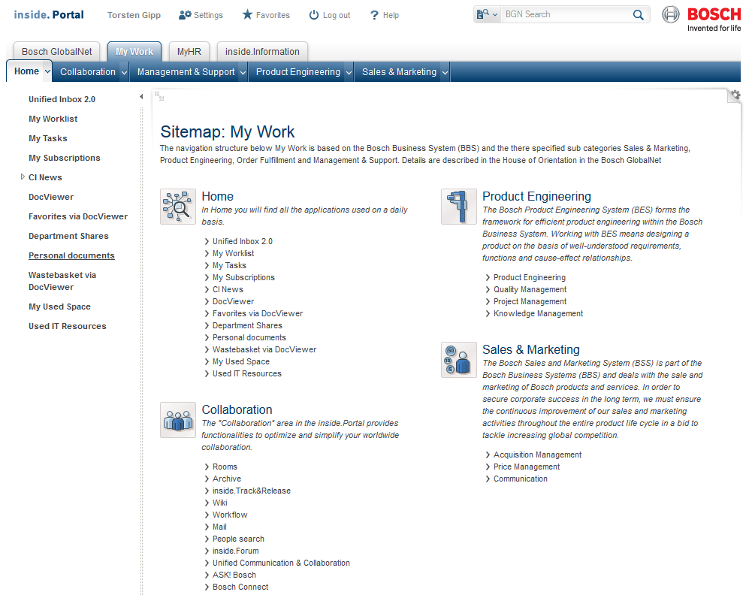

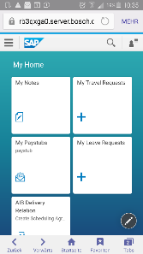
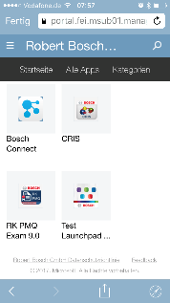
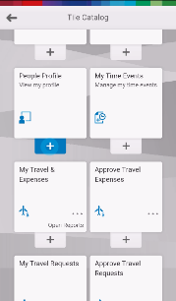

Fiori Launchpad Implementation Roadmap
Bosch Fiori Strategy
IG3
RG
RG
Fiori
Launchpad
Enable the Bosch System Landscape
End 2015
H2 2016
H1 2016
Full Integration – replacement of ‘classic’ portal UX (Desktop & Mobile) *
FLP on EP for ABAP Catalog
First Pilots mobile FLP via Airwatch and Fiori Client
FLP on EP for ABAP Catalog and
iView integration
FLP on mobile via Fiori Client, Airwatch and Intune
Not available
13
CI/BAA-UX | 27.07.2017
© Robert Bosch GmbH 2016. Alle Rechte vorbehalten, auch bzgl. jeder Verfügung, Verwertung, Reproduktion, Bearbeitung, Weitergabe sowie für den Fall von Schutzrechtsanmeldungen.

Slide 14
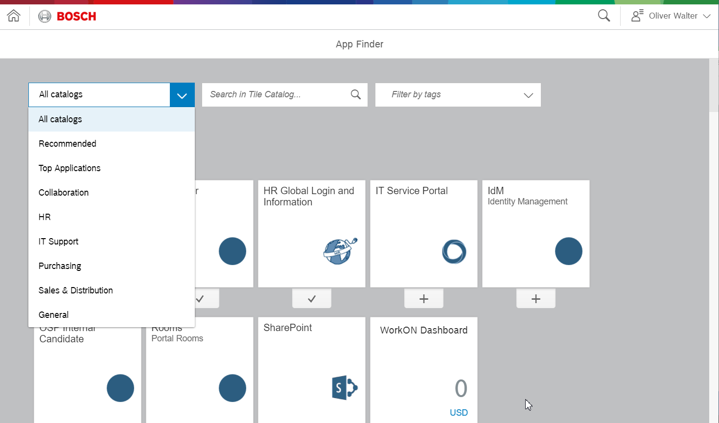
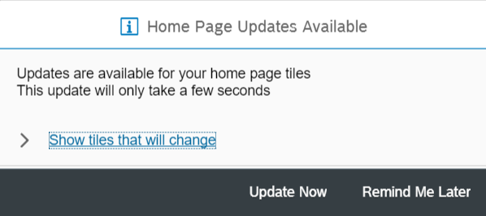
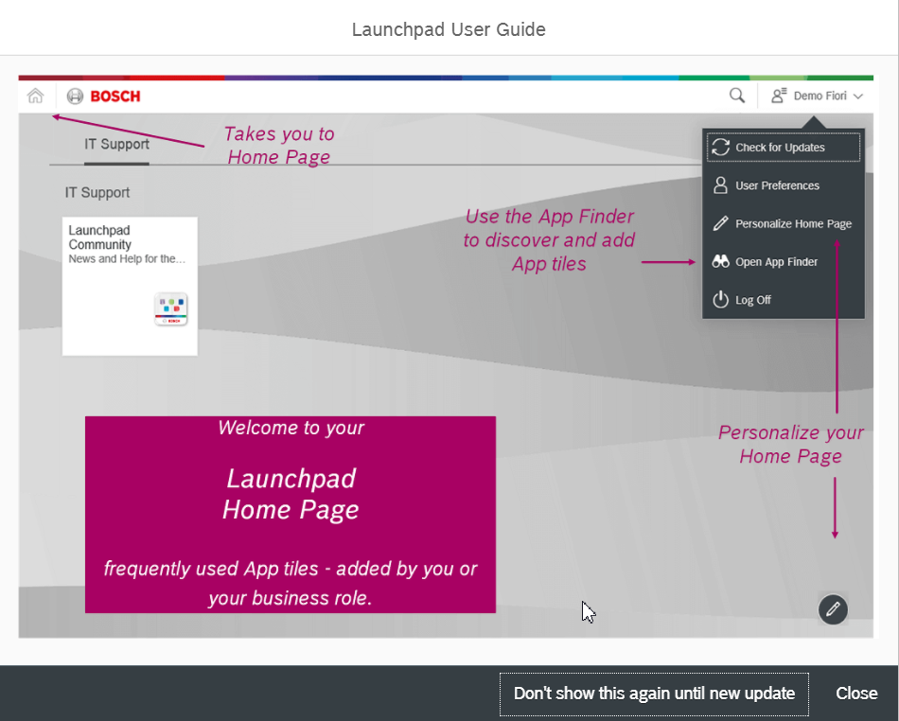
Fiori Launchpad Navigation
Bosch Fiori Strategy
Inside.Launchpad Homepage
Inside.Launchpad App Finder
- Personalize Home Page based on User needs
- Prefill only absolute necessary apps
- Train end user to use search functionality to access apps
Features
App Finder Categories - Recommended Apps - Top Applications - Collaboration - IT Support - Master Data - Purchasing - Sales & Distribution - General - …
Search in Appfinder by - Key Words - Category - App Name
Show Updates on the Homepage
First Steps
14
CI/BAA-UX | 27.07.2017
© Robert Bosch GmbH 2016. Alle Rechte vorbehalten, auch bzgl. jeder Verfügung, Verwertung, Reproduktion, Bearbeitung, Weitergabe sowie für den Fall von Schutzrechtsanmeldungen.

Slide 15
ACA App Portfolio Responsibility
Bosch Fiori Strategy
Fiori Core Team (CI/DAE3 + CI/CBD1)
Define Standards & Guidelines
Best Practices
Look & Feel
Take care on Launchpad Integration:
LoB Navigation Concept
Pre-filled Tiles
Catalog/Group Assignment
Portfolio of Apps
Capability Domain A
Project A
User Department Responsible Capability Fiori Consultant
Project B
Project C
…
Capability Domain B
Project A
User Department Responsible Capability Fiori Consultant
Project B
Project C
…
15
CI/BAA-UX | 27.07.2017
© Robert Bosch GmbH 2016. Alle Rechte vorbehalten, auch bzgl. jeder Verfügung, Verwertung, Reproduktion, Bearbeitung, Weitergabe sowie für den Fall von Schutzrechtsanmeldungen.

Slide 16
Bosch Fiori Landscape

Slide 17
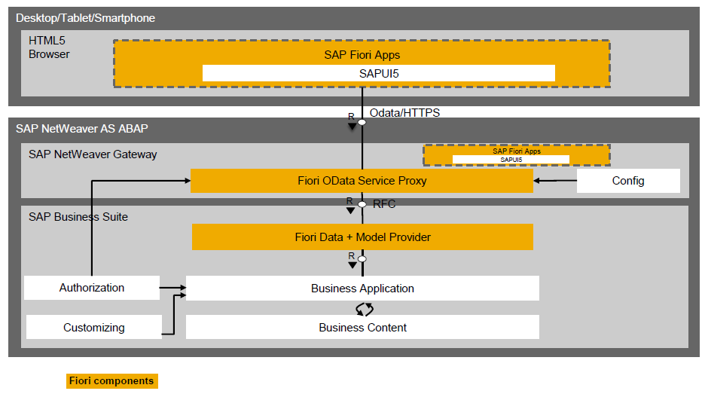
SAP Fiori Components
Bosch Fiori Landscape
Gateway Deployment Options
Central Hub Deployment
SAP Gateway (SAP_GWFND as of NW 7.40, GW_CORE < NW 7.40) is operated on central Gateway system
-> Recommended by SAP
Empedded Deployment
SAP Gateway (SAP_GWFND as of NW 7.40, GW_CORE < NW 7.40) is operated on related SAP Business System.
17
CI/BAA-UX | 27.07.2017
© Robert Bosch GmbH 2016. Alle Rechte vorbehalten, auch bzgl. jeder Verfügung, Verwertung, Reproduktion, Bearbeitung, Weitergabe sowie für den Fall von Schutzrechtsanmeldungen.

Slide 18



Bosch Fiori Frontend Server Architecture
Bosch Fiori Landscape
Desktop (BCN/RasVPN)
Tablet/Smartphone * (MSW)
* Including unmanaged devices. Requires MSW Account.
SL2
(slcs-sap-mobile)
System Information
System Owner | CI/OSI1
Development Coordination | CI/DAE3
Service Level | Silver (PXG)
SAP Netweaver | 7.50
SAP_UI | 200 SP6
sap.ui.version | 1.38.16
SAP Fiori Apps
Fiori
Frontend
Server
(xXG)
Bosch/3rd Party Apps
SAP_UI
Fiori Launchpad
IW_PGW
SAP_GWFND
Task-processing
Service
IW_FND/ GW_CORE
IW_BEP
Odata Service Proxies
Odata Model and Data Provider
FW
SL3 (Bosch
Corporate
Network)
Systems
PXG | Production | Link
QXG | Quality | Link
DXG | Development | Link
SXG | Sandbox | Link
SAP System with IW_BEP
3rd Party Systems
SAP Workflow
IW_BEP/ SAP_GWFND
Web/REST Service
Odata Model and Data Provider
Business application
Business application
18
CI/BAA-UX | 27.07.2017
© Robert Bosch GmbH 2016. Alle Rechte vorbehalten, auch bzgl. jeder Verfügung, Verwertung, Reproduktion, Bearbeitung, Weitergabe sowie für den Fall von Schutzrechtsanmeldungen.

Slide 19

Fiori System Landscape – High Level
Bosch Fiori Landscape
Runtime
Design-time
Mobile enabled apps
BUILD
WebIDE/Git
Microsoft intune
SAP Cloud Connector
Web Access Management (WAM)
inside.
Portal
Fiori Frontend
Server
Launchpad
Bosch Theme
3rd Party Apps
UI5/Fiori App
Launchpad Designer
SAP Gateway
Remote Content
Catalogs/Groups
OData Endpoints
3rd Party / Bosch Custom
SAP Business Suite / S/4HANA
Web apps
Web Dynpro & HTML Gui
Odata Data & Model Provider
19
CI/BAA-UX | 27.07.2017
© Robert Bosch GmbH 2016. Alle Rechte vorbehalten, auch bzgl. jeder Verfügung, Verwertung, Reproduktion, Bearbeitung, Weitergabe sowie für den Fall von Schutzrechtsanmeldungen.

Slide 20
Bosch Fiori Client Strategy

Slide 21
SAP Fiori Client Portfolio
Bosch Fiori Client Strategy
Feature comparison SAP Fiori Client – Hyprid app
Not in scope of Bosch
Supported Client Strategy
Concept done, not implemented yet
Native Device Feeling
Implementation Effort
SAP Business Client
Client installation required
SAP Fiori in Browser
HMTL5 Compliant Browser
No installation required
Coherent UX across all devices
SAP Fiori Client
Plugins for native device interaction
Attachment viewer
Improved Performance
Custom branding
Push Notifications
Full screen operations
Hybrid mobile app
Custom branded & pre-packaged apps
Not included in Launchpad
Offline capable
SAP Fiori iOS
For high-impact scenarios
Native iOS mobile experience
Complete custom development, no SAP portfolio
Launchpad
Desktop
Desktop & Mobile *
Mobile only
* Only from Bosch MSW
21
CI/BAA-UX | 27.07.2017
© Robert Bosch GmbH 2016. Alle Rechte vorbehalten, auch bzgl. jeder Verfügung, Verwertung, Reproduktion, Bearbeitung, Weitergabe sowie für den Fall von Schutzrechtsanmeldungen.
Notes:
Option 4 and 5 may require additional WAM instance

Slide 22
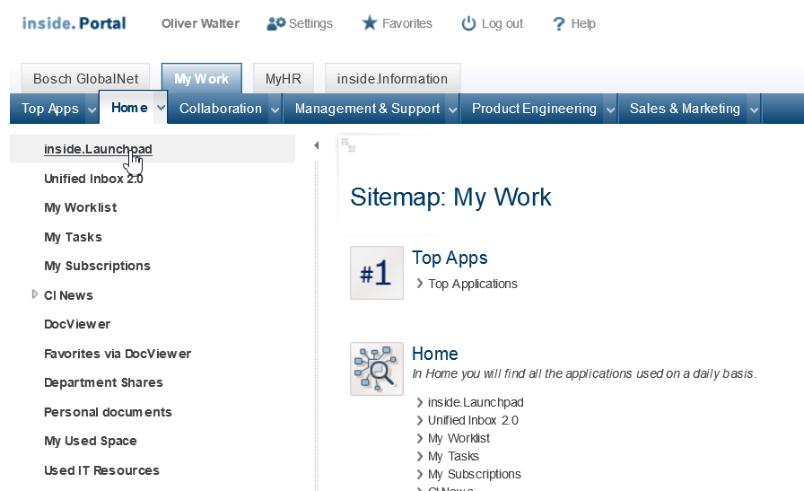
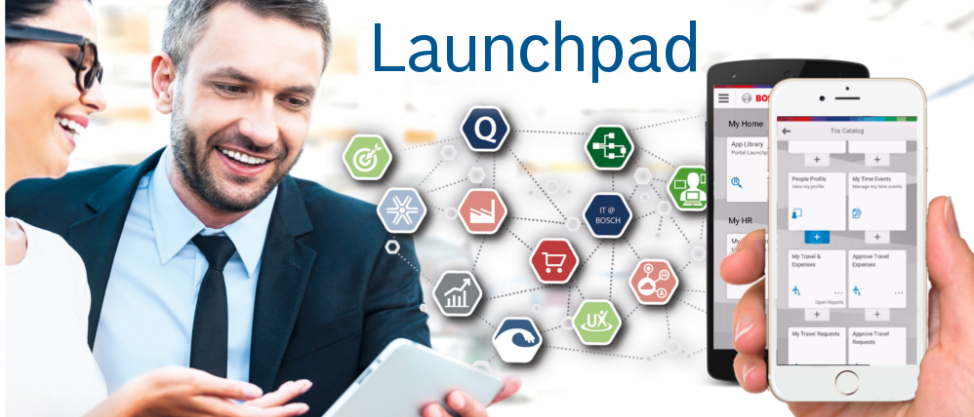






Bosch Launchpad on Desktop and Mobile
Titel des Kapitels
Desktop
Mobile
https://inside.bosch.com/irj/portal/fiori
https://appcenter.bosch.com/enterprise/details/-/app/Launchpad
Supports Bosch certified Browser:
Internet Explorer (IE11) *
Firefox ESR (45.x) *
Chrome (planned)
Mobile Launchpad app available for:
iOS on MS intune*
Android on Airwatch * *
* Tested on Windows 7, 8.1, 10
* No new features, due to phase-out 07/2018.
22
CI/BAA-UX | 27.07.2017
© Robert Bosch GmbH 2016. Alle Rechte vorbehalten, auch bzgl. jeder Verfügung, Verwertung, Reproduktion, Bearbeitung, Weitergabe sowie für den Fall von Schutzrechtsanmeldungen.

Slide 23

Mobile Client Communication Path
Bosch Fiori Client Strategy
Currently in preparation
P-Intune
Bosch AD/MFA
PCZ
Inside.Portal
Launchpad
https://stfs.bosch.com/adfs/
Launchpad app
P-WAM
RBMD_Launchpad_Group
Every Bosch User
https://rb-wam-ms-portal.bosch.com
Productive User Devices
P- WAP
PXG
SAP Gateway
UI5/Fiori apps
https://rb-ms-mobile-portal.bosch.com
QA Launchpad app
https://rb-ms-mobile-portal-q.bosch.com
Q-WAM (TEST)
RBMD_Launchpad_QA_Group
CI and UD Keyuser
https://rb-wam-ms-portal-q.bosch.com
Q9 AD/MFA
QCZ
Inside.Portal
Launchpad
Q
https://stfs.test-bosch.com/adfs/
Q-Intune
Department Devices
Test Launchpad app
Q-WAM (DEV)
Q-WAP
QXG
SAP Gateway
UI5/Fiori apps
RBMD_Launchpad_Test_Group
Fiori Core Team
https://rb-mobile-ms-fiori-q.bosch.com
https://rb-wam-ms-fiori-q.bosch.com
23
CI/BAA-UX | 27.07.2017
© Robert Bosch GmbH 2016. Alle Rechte vorbehalten, auch bzgl. jeder Verfügung, Verwertung, Reproduktion, Bearbeitung, Weitergabe sowie für den Fall von Schutzrechtsanmeldungen.

Slide 24
Feature Matrix: Launchpad Client – Hyprid App
Bosch Fiori Client Strategy
Back
Feature | Fiori Launchpad Client* | Hyprid Mobile App
Single Sign On | Yes (see Bosch Fiori Launchpad Client Setup) | No
Flexible with SAP_UI AddOn version | No | Yes
Global Style Sheets (inside.Portal) | Yes | No
Native App feeling | No | Partially
Rollout | Fiori app rollout via IdM (No app publishing required) | Per appenrollment + IdM
Offline Support | No | Yes (requires SMP or HCPms and SAP mobile secure **)
Native device features | Yes (Out of the box support: SAP Fiori Client Feature Matrix, custom AddOns can be added) | Yes
Push notfications | Planned for Notification Center | Yes, per app.
Mobile and Desktop | Yes | No
App – app navigation | Yes | Must be implemented in coding
24
CI/BAA-UX | 27.07.2017
© Robert Bosch GmbH 2016. Alle Rechte vorbehalten, auch bzgl. jeder Verfügung, Verwertung, Reproduktion, Bearbeitung, Weitergabe sowie für den Fall von Schutzrechtsanmeldungen.
Notes:
TODO: * + ** überarbeiten

Slide 25
Launchpad Client - Device Feature Matrix
Bosch Fiori Client Strategy
The Bosch Launchpad Client supports already out-of-the-box several native device features. The following table shows some important SAP Kapsel and Cordova plugins, that can already be used.
Plugin | Description | Implemented | Vendor
Attachment Viewer Plugin | The Attachment Viewer plugin enhances the viewing of an attachment within the Fiori App. If no suitable viewer is present, the plugin displays an error message. | Yes | SAP
Barcode Scanner Plugin | Enables the Fiori applications to scan and decode a barcode using the device camera. | Yes | SAP
Cache Manager Plugin | Improve the performance of SAP Fiori applications with disk caching of web assets of SAP Fiori applications. | Yes | SAP
Calendar Plugin | Enables Fiori applications to use the default calendar. | Yes | SAP
Camera Plugin | Take pictures with the device camera and choose images from the system's image library. | Yes | npm
Contacts Plugin | Provides access to the device contacts database | Yes | npm
Encrypted Storage Plugin | Provides an encrypted local storage mechanism to that allows a Fiori application's private data to be stored on the user's device. | Yes | SAP
Geolocation Plugin | This plugin provides information about the device's location, such as latitude and longitude. | Yes | npm
Printer Plugin | Enables Fiori applications to print documents. Supports printin in 3 ways: from Current Page, Attachment Viewer, Background printing | Yes | SAP
Voice Recording Plugin |  | Yes
Push Notification Plugin |  | No *
* Requires SAP Mobile Platform or HCPms with APNS or GCM
Source: https://uacp2.hana.ondemand.com/doc/38ec5403bfbf4d7a8fdd3fee5f9605e0/3.0.14/en-US/dd84adc65a5e4a2490e52d2394b7d954.html (02/2017)
25
CI/BAA-UX | 27.07.2017
© Robert Bosch GmbH 2016. Alle Rechte vorbehalten, auch bzgl. jeder Verfügung, Verwertung, Reproduktion, Bearbeitung, Weitergabe sowie für den Fall von Schutzrechtsanmeldungen.

Slide 26
App Types – Device Compatibility Matrix *
Bosch Fiori Client Strategy
Security Layer (SL) see slide 14
* Cloud based applications not evaluated yet.
Fiori Frontend Server
inside.Portal
UI Runtime (SL2)
SAP Backend (SL3)
UI Runtime (SL3)
Fiori and UI5 apps
(Mobile first designed)
Fiori and UI5 apps
(Not optimized for smartphones)
SAP Fiori / UI5 apps
(Mobile first designed)
SAP Fiori / UI5 apps
(Not optimized for smartphones)
3rd Party HTML apps
(Mobile first designed)
3rd Party HTML apps
(Not optimized for smartphones)
Web Dynpro / HTML Gui apps
3rd Party HTML apps
* Technically possible, but limited UX.
26
CI/BAA-UX | 27.07.2017
© Robert Bosch GmbH 2016. Alle Rechte vorbehalten, auch bzgl. jeder Verfügung, Verwertung, Reproduktion, Bearbeitung, Weitergabe sowie für den Fall von Schutzrechtsanmeldungen.
Notes:
Matrix Tabellarisch

Slide 27
Bosch Fiori Role and Authorization Conceptss

Slide 28

Runtime Authorization Overview
Fiori Roles and Authorizations
Layer | Productive Landscape | Test Landscape | Development Landscape
Mobile Device Management | iOS (intune): RBMD_Launchpad_Group Android (Airwatch): and-Launchpad-app | iOS (intune): RBMD_Launchpad_Test_Group Android (Airwatch): and-test Launchpad-app | NA
Web Access Management | P-IdM Resource: WAM Role: tam-fiori-mobile-allow-internet | Q-IdM Resource: WAM Role: tam-fiori-mobile-allow-internet | NA
Portal (Launchpad) | P-IdM Resource: Portal Roles: rb_inside_Launchpad_users <fiori-catalog-IdM-grp> | Q-IdM Resource: Portal Roles: rb_inside_Launchpad_users <fiori-catalog-IdM-grp> | D-IdM Resource: Portal Roles: rb_inside_Launchpad_users <fiori-catalog-IdM-grp>
Fiori Frontend | P-IdM Resource: PXG011 Roles: <fiori-catalog-role> | P-IdM Resource: QXG011 Roles: <fiori-catalog-role> | P-IdM Resource: DXG011 Roles: <fiori-catalog-role>
Backend System | P-IdM Resource: <Backend> Roles: <Roles> | P-IdM Resource: <Backend> Roles: <Roles> | P-IdM Resource: <Backend> Roles: <Roles>
Enterprise Mobile Management
Web Access
Management
inside.
Portal
SAP
Gateway
Catalogs/Groups
OData Endpoints
Backend
Systems
Odata Data & Model Provider
28
CI/BAA-UX | 27.07.2017
© Robert Bosch GmbH 2016. Alle Rechte vorbehalten, auch bzgl. jeder Verfügung, Verwertung, Reproduktion, Bearbeitung, Weitergabe sowie für den Fall von Schutzrechtsanmeldungen.

Slide 29
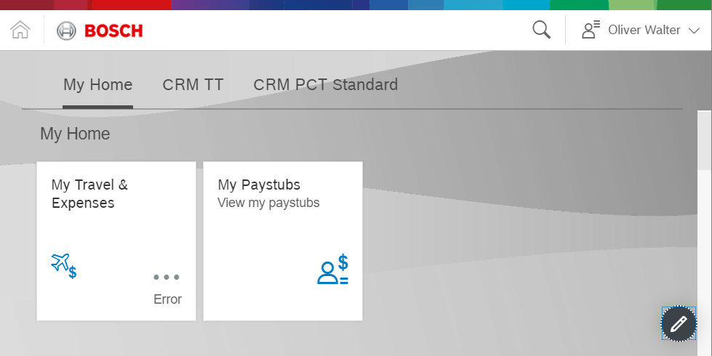
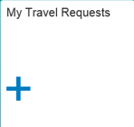
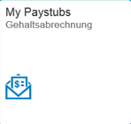
IdM Roles in Detail
Fiori Roles and Authorizations
IdM - Pre-approved default roles
IdM - Business Roles
inside.Portal
rb_inside_launchpad_users *
rb_flp_<mo>_<fiori use-case>
Fiori Launchpad Access
Personalization
Default Content
Launchpad Category
Remote Gateway Catalogs
Portal Business Content
* Pre-approved but not default yet
Remote Content
SAP Gateway
Fiori
Tile
Catalog
X:0GXX_FIORI_ALL_MINUSER
X:0G<MO>_<UseCase>(_<SID>)
One Business Role not supported by IdM
Basic Fiori OData Services
Default Content (All User)
Fiori Business Catalog
Fiori Business Service (R3TR IWSG)
Fiori Business Group (optional)
Fiori Odata Service Proxy
tRFC
Backend
Systems
Fiori Data + Model Provider
Z:A1SY_STAR_ALL_M_MINUSER(_HR)
(Existing) Business Role
R
Authorization
Buiness Application
Logon via Trusted RFC (xXG)
Basic WF Services
Add to composite role, e.g. X:04XX_STAR_UBK_BASIC_ROLE
Fiori Business Service (R3TR IWSV)
Authoriazion for business application and data
Customizing
Business Content
29
CI/BAA-UX | 27.07.2017
© Robert Bosch GmbH 2016. Alle Rechte vorbehalten, auch bzgl. jeder Verfügung, Verwertung, Reproduktion, Bearbeitung, Weitergabe sowie für den Fall von Schutzrechtsanmeldungen.

Slide 30
Central re-usable IdM Roles
Fiori Roles and Authorizations
Rolename | Description | Target Group | MoR | Wf-Type | System
X:0GXX_FIORI_ALL_MINUSER | Access to Fiori launchpad Preapproved role | All Bosch users | CI/OSI1 | 0 | DXG, QXG, PXG
X:0GSY_FIORI_SUPPORT | Supports Incident and problem Management for Fiori Apps on P-Platform with access to basis support tools | CI/RBEI application support groups | CI/OSI1 | 0 | PXG
X:0GSY_FIORI_SUPPORT_NON_P | Supports Incident and problem Management for Fiori Apps on Non-P-Platform with access to basis support tools and traces | CI/RBEI application support groups | CI/OSI1 | 0 | DXG, QXG
X:0GSY_FIORI_SUPPORT_CORE | Base application setup configuration | Fiori Core Team | CI/OSI1 | 2 | DXG, QXG, PXG
X:0GDV_FIORI_ADMIN_LP | Access to Fiori Launchpad Designer Driver license needed | Fiori Core Team | CI/DAE3 | 2 | DXG
X:0GDV_FIORI_DEV_UI5 | Access to SAPUI5 developer tools Developer Key and Driver license needed | SAPUI5 developers worldwide | CI/DAE3 | 2 | DXG
X:A1DV_XXXX_DEV_SOA_ALL | Odata service development is done on Back-End system. Requires additional base role X:A1DV_STAR_DEV_ABAP_ALL for full OData development authorization. | OData developers worldwide | CI/DAE2s | 2 | D-Systems
Z:A1SY_STAR_ACA_M_SUPPORT_SYST | SAP UI5/Fiori Support Role for Backend Systems | CI/RBEI application support groups | CI/DAD1 | 0 | P-Systems
Z:A1SY_STAR_ALL_M_MINUSER(_HR) | Central Minuser Role for SAP Backend Systems | All Bosch users | CI/DAD1 | 0 | All SAP Systems
Source: https://inside-docupedia.bosch.com/confluence/display/SFSD/Role+Overview
30
CI/BAA-UX | 27.07.2017
© Robert Bosch GmbH 2016. Alle Rechte vorbehalten, auch bzgl. jeder Verfügung, Verwertung, Reproduktion, Bearbeitung, Weitergabe sowie für den Fall von Schutzrechtsanmeldungen.

Slide 31
Bosch Fiori Collaboration Model

Slide 32
Overview
Bosch Fiori Collaboration Model
Governance & Guidelines | Application Development | Application Support
2nd Support
(DA)
CI Project
(DA)
Capability Developer
Fiori
(DA)
Fiori
Core Team
CI/DAE3,
CI/DAD5.1
CI/CBD1
CI/OSI1
Capability Developer
Fiori Configurator
(DA)
3rd Support
(DA)
32
CI/BAA-UX | 27.07.2017
© Robert Bosch GmbH 2016. Alle Rechte vorbehalten, auch bzgl. jeder Verfügung, Verwertung, Reproduktion, Bearbeitung, Weitergabe sowie für den Fall von Schutzrechtsanmeldungen.

Slide 33
Organizational Units and Tasks
Bosch Fiori Collaboration Model
Fiori
Core Team
CI/DAE3,
CI/DAD5.1
CI/CBD1
CI/OSI1
Capability Developer
Fiori Configurator
(DA)
Capability Developer
Fiori
(DA)
Support
(DA)
Fiori Architect
Product Management (Fiori Mobile Client, Portal Launchpad)
Developer Lead Fiori
Quality Checks (e.g. OData & SAPUI5 Code Review, OSS scan, UI review)
Guidelines (Developer Handbook & Process)
Training concept definition
Provide development environment (WebIDE)
Transport management
System Owner Front-End Server
First Technical Contact for new Applications
Life Cycle Management
Engage with SAP (e.g. roadmap dialogs)
Fiori Development co-ordination & configuration, e.g.
Guide projects through development processes
Fiori Development process
Portal Application Integration Process
Fiori Product Installations (Front-End server)
Application role management (Portal & Front-End & Back-End server)
Application & Developer package creation (Front-End server)
Service registration (Front-End server)
Catalogs & Groups configuration (Front-End server)
Consulting in Fiori technology
Extend or implement Fiori application
Odata Service development (incl. backend logic)
Back-End customizing
2nd Level
Dispatching
Analyse issues End-to-End cross platforms (Mobility, WAM, Portal, Front-End Server, Back-End Server)
Solve Authorization issues and other support standard tasks
3rd Level
Bug fixing
Portal
SAPUI5
Odata
Business Logic
33
CI/BAA-UX | 27.07.2017
© Robert Bosch GmbH 2016. Alle Rechte vorbehalten, auch bzgl. jeder Verfügung, Verwertung, Reproduktion, Bearbeitung, Weitergabe sowie für den Fall von Schutzrechtsanmeldungen.

Slide 34
Responsibility by Component
Bosch Fiori Collaboration Model
Fiori
Tasks
Platforms
Tasks
CI/BDM-EU
Launchpad Client app development & publishing
Launchpad Client app
CI/CBR3-NA?
Browser Support
Device Integration (VPN)
Operating System
Microsoft intune
CI/CBR3-NA
Bosch App Store
Device enrollment
Central Launchpad
Support
Web Access
Management (WAM)
CI/ISI1
Security, Routing
inside.
Portal
ACA (PPS)
Launchpad Integration
Authorization, Category assignment + Remote Catalog Mapping, Theming + UI compliance, Personalization
Enterprise Portal & Collaboration
General Launchpad Operation
SAP
Gateway
ACA
Customizing
EAI Platforms
Gateway System Line
Operation and Installation
SAP UI5/Fiori app Support
Catalogs/Groups
ACA
UI development
OData Endpoints
Backend
Systems
ACA
Application logic
Integration Components
OS
Backend System Operation and Installation
Odata Data & Model Provider
34
CI/BAA-UX | 27.07.2017
© Robert Bosch GmbH 2016. Alle Rechte vorbehalten, auch bzgl. jeder Verfügung, Verwertung, Reproduktion, Bearbeitung, Weitergabe sowie für den Fall von Schutzrechtsanmeldungen.

Slide 35
Support Organization
Bosch Fiori Collaboration Model
Platform Support
1st Level
2nd Level
3rd Level
SAP UI5/Fiori app Support
CI/OS
<ACA 2nd Level Support>
<ACA 3rd Level
Support>
Solve issue if possible
Route according error case
CI Hotline 1st Level Support
User
Key-user
Enterprise Portal &
Coll.
EAI
Platforms
CI Hotline 2nd Level Launchpad Support
Central Launchpad
Support
Route according error case
CI/ISI
CI/BDM-
EU
Re-use existing inside.Portal 1st, 2nd and 3rd Level Support Organization for general Fiori Launchpad support.
CI/CBR3-
NA
35
CI/BAA-UX | 27.07.2017
© Robert Bosch GmbH 2016. Alle Rechte vorbehalten, auch bzgl. jeder Verfügung, Verwertung, Reproduktion, Bearbeitung, Weitergabe sowie für den Fall von Schutzrechtsanmeldungen.

Slide 36
Training Concept
Bosch Fiori Collaboration Model
Role | Training (mandatory)
Fiori Core Team | UX100 Fiori-Introduction* IT-BGN017 Portal Admin*
CI Project Lead | UX100 Fiori-Introduction*
Fiori Configurator | UX100 Fiori-Introduction* IT-BGN017 Portal Admin* IT-BGN018 Portal Admin Certification* Introduction by CI/DAE3*
Developer Team SAPUI5 | BSC-UI-400** or UX402* SAPUI5 development or RBEI Curriculum*** Introduction by CI/DAE3*
Developer Team Odata | BSC-TEC-600** or GW 100* OData Services or RBEI Curriculum***
2nd Level Support | Introduction by CI/DAE3*
3rd Level Support | UX100 Fiori-Introduction* BSC-UI-400** or UX402* SAPUI5 development BSC-TEC-600** or GW100* OData Services IT-BGN017 Portal Admin* IT-BGN018 Portal Admin Certification*
* Worldwide, ** Germany, *** India
36
CI/BAA-UX | 27.07.2017
© Robert Bosch GmbH 2016. Alle Rechte vorbehalten, auch bzgl. jeder Verfügung, Verwertung, Reproduktion, Bearbeitung, Weitergabe sowie für den Fall von Schutzrechtsanmeldungen.

Slide 37
Bosch Fiori Development

Slide 38
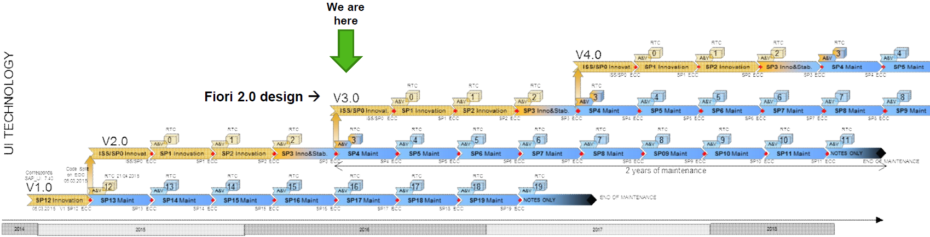
SAPUI5 Framework - Lifecycle
Fiori Development
Current central Bosch Fiori Version
Version planned in Q1/2018
Version required for S/4HANA 1709
UI Technology
38
CI/BAA-UX | 27.07.2017
© Robert Bosch GmbH 2016. Alle Rechte vorbehalten, auch bzgl. jeder Verfügung, Verwertung, Reproduktion, Bearbeitung, Weitergabe sowie für den Fall von Schutzrechtsanmeldungen.

Slide 39
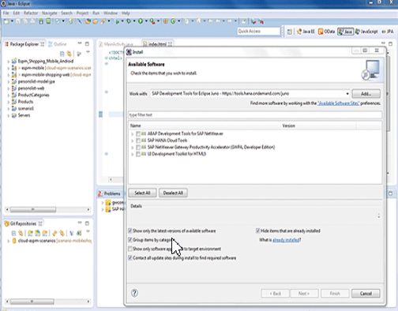
Tiered Layer Development
Fiori Development
Exemplary Central Development. Fits to any GB System Line as well.
BUILD
WebIDE/Git
DXG
QXG
PXG
/RB0G/ - UI Package
/RB0G/ - Package
/RB0G/ - Package
TRDXG-4712
TRDXG-4712
OData Proxy
OData Proxy
OData Proxy
Package Relation
FW
RFC/tRFC
RFC/tRFC
RFC/tRFC
DC 8
SID
P<SID>
/RB9x/ - Package
/RB9x/ - Package
/RB9x/-package
Model and Data Provider
TRDC8-4711
Model and Data Provider
TRDC8-4711
Model and Data Provider
Business Application
Business Application
Business Application
SAP Business Suite, S/4HANA
SAP Business Suite, S/4HANA
SAP Business Suite, S/4HANA
Distribution/Test
Production
39
CI/BAA-UX | 27.07.2017
© Robert Bosch GmbH 2016. Alle Rechte vorbehalten, auch bzgl. jeder Verfügung, Verwertung, Reproduktion, Bearbeitung, Weitergabe sowie für den Fall von Schutzrechtsanmeldungen.
Notes:
Transport Prozeduren der verschiedenen Systemlinien
Portal hinzufügen

Slide 40
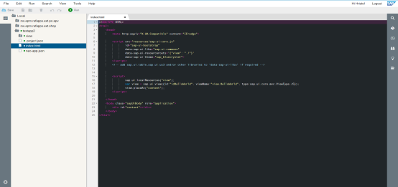

Central WebIDE
Fiori Development
HTTPS Tunnel
1.
Read/Write Business Data
2.
Deploy Source Code
SAP HANA Cloud Platform
SAP HANA Cloud Platform
SAP HANA
Cloud Platform
Account Cockpit
Virtual destinations
SAP
WebIDE
GIT Repository
Internet
1.
2.
2.
Odata Proxies
Gateway UI5 Runtime
Portal UI5 Runtime
SAML Assertion
SAP HANA Cloud Connector
Source Mappings
SL1
Odata Proxies
Gateway UI5 Runtime
Portal UI5 Runtime
Username/Password *
SAP Netweaver Gateway
(DXG, SXG)
Bosch internal SAML IdP
SL2
Odata Proxies
UI5 Runtime
UI5/Fiori apps
WAM
TFIM
Trusted RFC
Username/Password *
SAP Business Suite (DEV, X-,
Y-, Z-Systems)
Inside.Portal (DCW, DCZ)
SL3
Odata Model and Data Provider
UI5 Runtime
Launchpad
SAP Business Application
UI5 apps
SAP HANA Cloud
Platform Account Admin
SAP WebIDE
UI Developer
* Planned to replace with SSO
40
CI/BAA-UX | 27.07.2017
© Robert Bosch GmbH 2016. Alle Rechte vorbehalten, auch bzgl. jeder Verfügung, Verwertung, Reproduktion, Bearbeitung, Weitergabe sowie für den Fall von Schutzrechtsanmeldungen.
Notes:
Currently with Eclipse
Driver License
WebIDE planned date

Slide 41
CI WebIDE Architecture
Fiori Development
Internet
RB SL1-DMZ
RB SL2-ESZ
RB SL3-BCN
SAP Cloud Platform
Bosch Tenant
SAML Trust
Authenticate
Identity Provider
WAM + TFIM
slcs-intra-???: IP: ???
GIT
WebIDE
Source Code Rep.
UI5 Design Time
https
SAML Token
dmz-afw2-mobile: SI0VMS0246.de.bosch.com
IP: 139.15.228.74
https (planned)
WAM
Inside.Portal
(DCZ, DCZx)
SAP Cloud Connector
slcs-sap-mobile: SXG: 10.35.49.93 DXG: 10.35.49.52
RFC, tRFC
Destinations
Virtual Destinations
SAP CRM
e.g. DTS, DCT
HTTPS Tunnel
https
SAP Gateway
(DXG, SXG)
UI5 Runtime
SAP ERP
e.g. BBM-RM, HR DEV & Test Systems
41
CI/BAA-UX | 27.07.2017
© Robert Bosch GmbH 2016. Alle Rechte vorbehalten, auch bzgl. jeder Verfügung, Verwertung, Reproduktion, Bearbeitung, Weitergabe sowie für den Fall von Schutzrechtsanmeldungen.

Slide 42
Fiori Information & Examples

Slide 43
Fiori Information in Bosch
Fiori Information & Examples
General SAP Fiori/UI5 Information on Business Level
Bosch Connect SAP UI Technologies
DXG Developer Community
Bosch Connect SAP Fiori / SAPUI5 Development
DXG SAP Fiori / SAPUI5 Development Handbook, Landscape, Processes, Responsibilities
Inside.Docupedia SAP Fiori / SAPUI5 Developement@Bosch
43
CI/BAA-UX | 27.07.2017
© Robert Bosch GmbH 2016. Alle Rechte vorbehalten, auch bzgl. jeder Verfügung, Verwertung, Reproduktion, Bearbeitung, Weitergabe sowie für den Fall von Schutzrechtsanmeldungen.

Slide 44
SAP Information
Fiori Information & Examples
SAP Fiori App Library: https://fioriappslibrary.hana.ondemand.com/sap/fix/externalViewer/#
SAP Fiori Demo Cloud Edition https://www.sapfioritrial.com/
SAP Fiori Design Guidelines: https://experience.sap.com/fiori-design-web/explore/
SAP Fiori Controls Explored: https://sapui5.netweaver.ondemand.com/sdk/explored.html
44
CI/BAA-UX | 27.07.2017
© Robert Bosch GmbH 2016. Alle Rechte vorbehalten, auch bzgl. jeder Verfügung, Verwertung, Reproduktion, Bearbeitung, Weitergabe sowie für den Fall von Schutzrechtsanmeldungen.

Slide 45
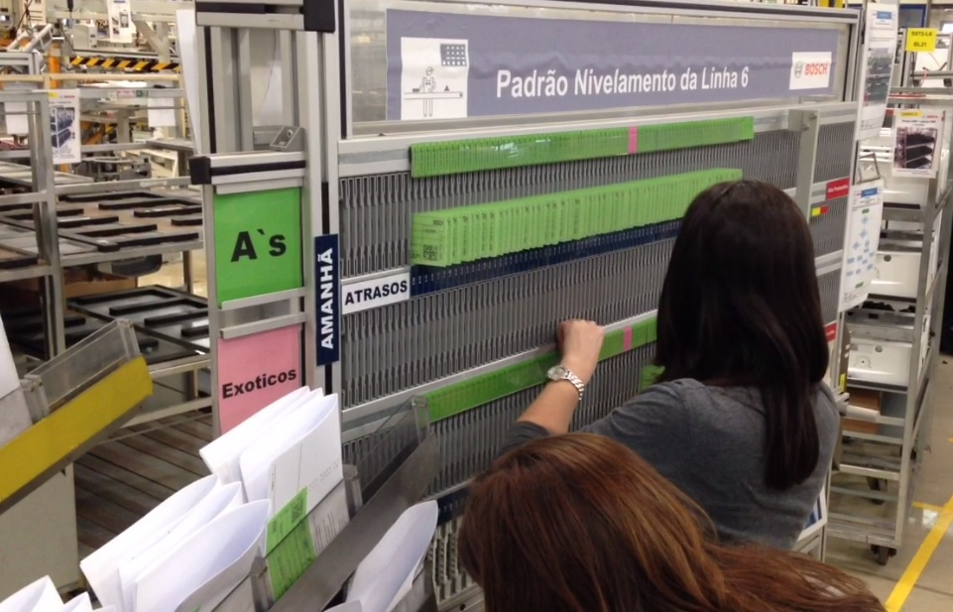
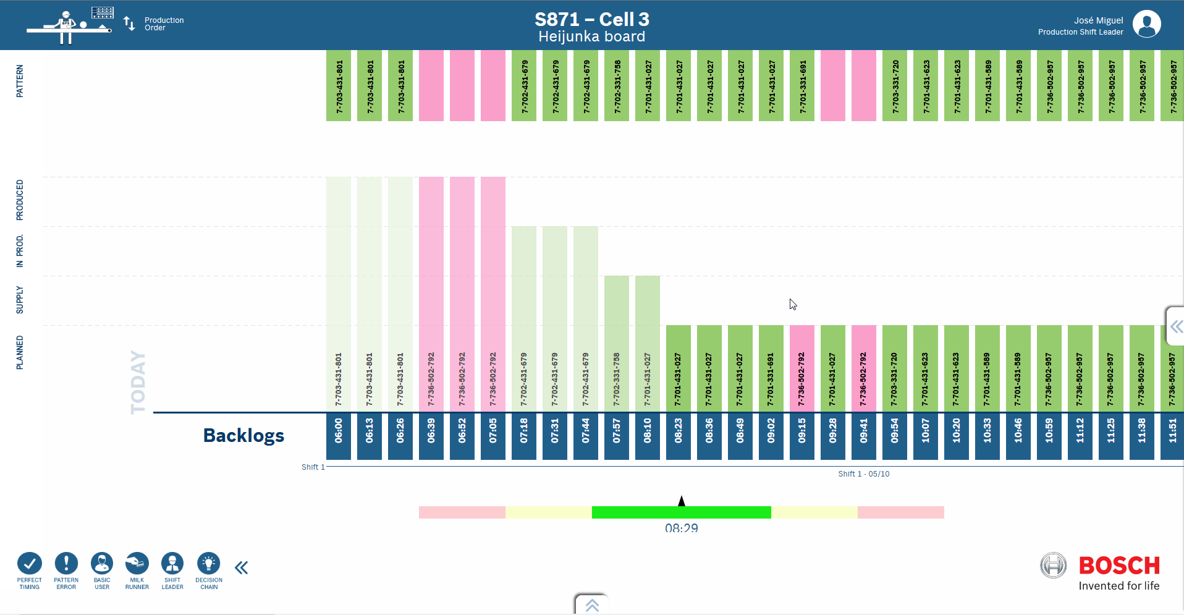
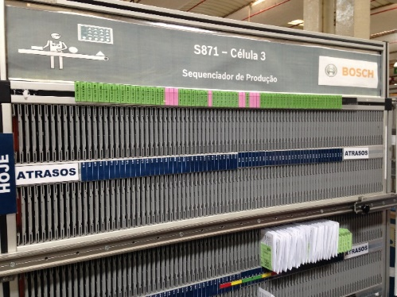
I4.0 – Levelling Board
Fiori Information & Examples
Basic Information
Location: Plant Aveiro, Portugal
Users: Production Workers, Shift Planner
System: PCE
Contact: Santos Pedro Miguel (CI/CWR2-IB)
Use Case Description:
In the Bosch plant Aveiro (AvG) in Portugal, Levelling Boards with Kanban paper cards were used to control & track the production order progress. The plant was able to remove the manually created error prone Levelling Boards and to replace them with modern flat screens using the new Fiori app which is directly connected to the SAP system. For further details, please refer to the Video
45
CI/BAA-UX | 27.07.2017
© Robert Bosch GmbH 2016. Alle Rechte vorbehalten, auch bzgl. jeder Verfügung, Verwertung, Reproduktion, Bearbeitung, Weitergabe sowie für den Fall von Schutzrechtsanmeldungen.

Slide 46
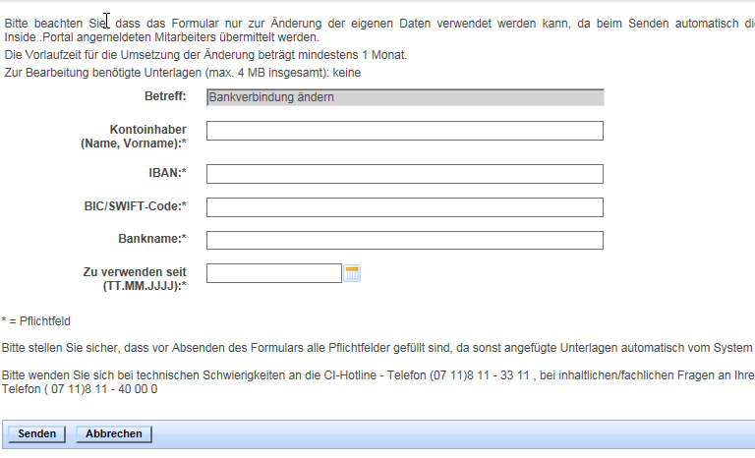
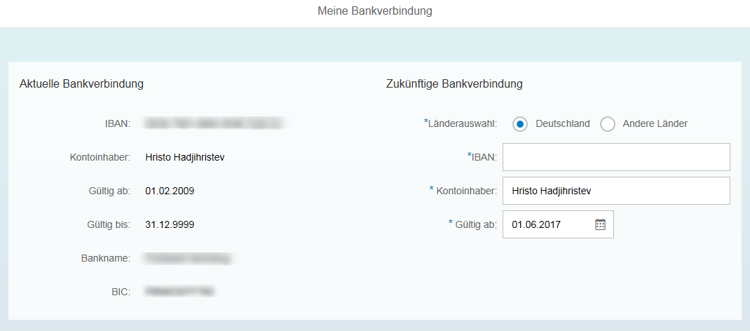
HR – Change Address & Bank Account
Fiori Information & Examples
Basic Information
Location: Germany
Users: All German employees
System: BOPAS (P70)
Contact: Eger Stefan (CI/DAV7.1)
Use Case Description:
In the past, employees had to submit a ticket in order to get their personal data changed. With the new Fiori app German employees are now able to maintain this information directly by themselves instead of being manually typed in by a service center employee. Further ESS/MSS scenarios are planned or already in development (My Payslips, Time Management).
Try it by yourself: Change your Bank Account Change your Address
46
CI/BAA-UX | 27.07.2017
© Robert Bosch GmbH 2016. Alle Rechte vorbehalten, auch bzgl. jeder Verfügung, Verwertung, Reproduktion, Bearbeitung, Weitergabe sowie für den Fall von Schutzrechtsanmeldungen.

Slide 47
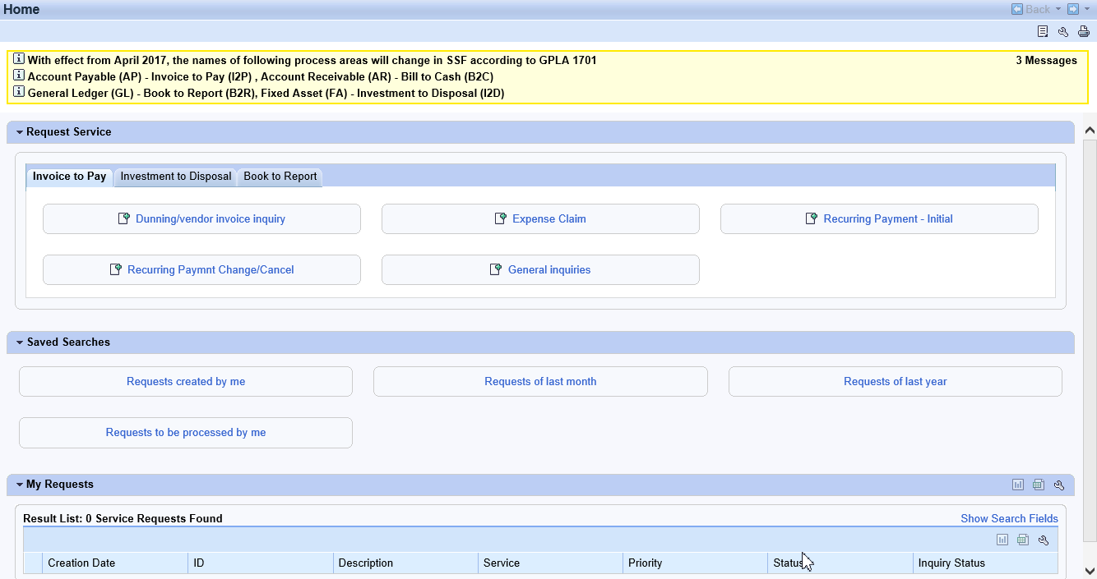
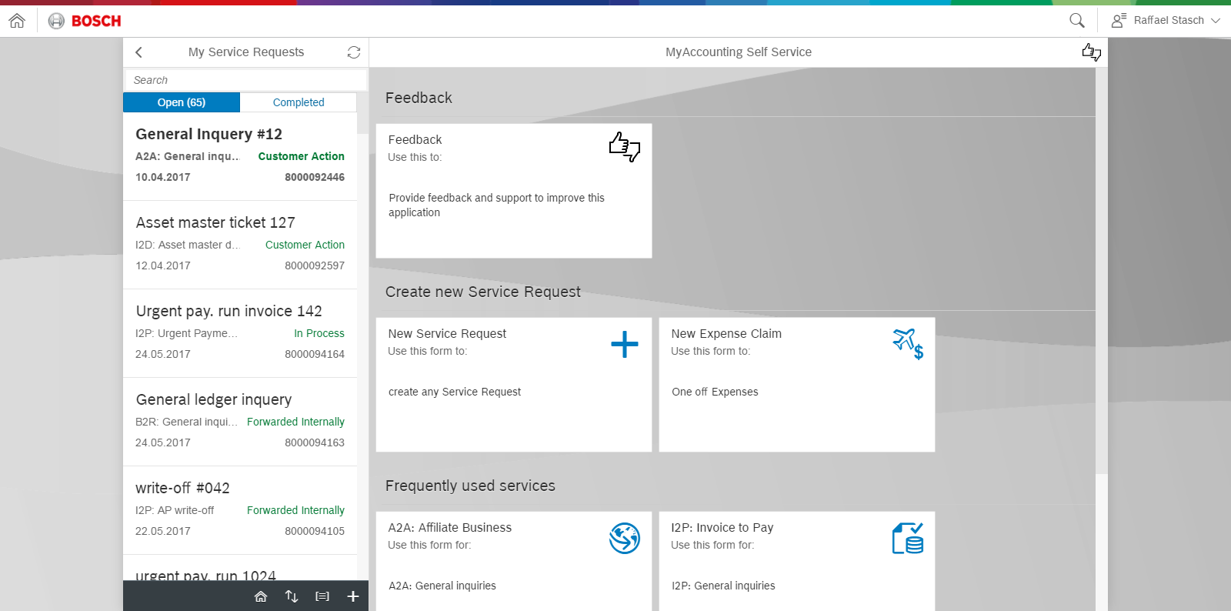
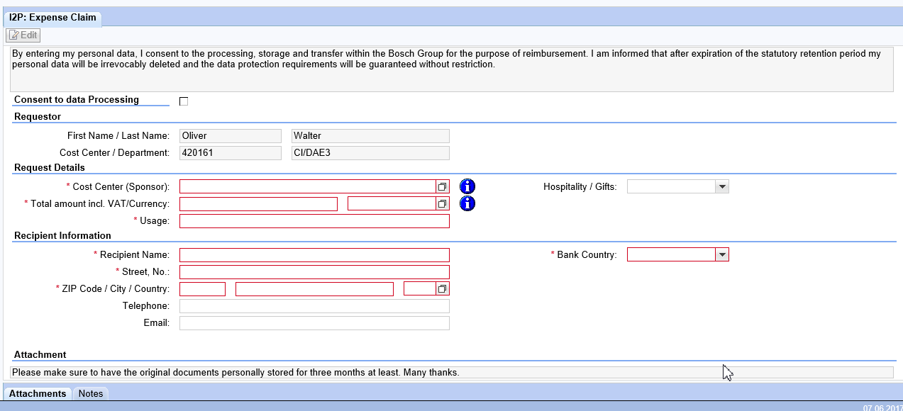
SSF FI – My Accounting Self-Service
Fiori Information & Examples
Basic Information
Location: Worldwide Rollout (DE not available yet)
Users: All Bosch employees
System: PDX
Contact: Stasch Raffael (CI/DAV1.3)
Use Case Description:
To request an expense claim employees used a WebDynpro based transaction.
Now a new Fiori app is available, which allows the users to easily create any kind of requests, in future also from mobile devices.
For further details, please refer to the Video or to the Bosch Connect Blog
47
CI/BAA-UX | 27.07.2017
© Robert Bosch GmbH 2016. Alle Rechte vorbehalten, auch bzgl. jeder Verfügung, Verwertung, Reproduktion, Bearbeitung, Weitergabe sowie für den Fall von Schutzrechtsanmeldungen.

Slide 48
Backup

